Slide 1
Ekoji Sangha Annual Meeting
Sunday, 15 november 2020

Slide 2
Agenda
Opening Gassho
Attendance and Zoom Protocol
Rev Hayashi’s Report
Presidents’ 2020 Review
Review/Vote on 2019 Annual Meeting Minutes
Election of New Officers and Trustees
2020 Financial Report
2021 Proposed Budget
Open Discussion
Closing Gassho

Slide 3
Zoom Protocol & Roll Call
Please stay muted unless you have a question or comment.
Enabling video is welcome unless the connection becomes unstable.
Please rename your name to your Ekoji member name for roll call and vote counting purposes.
Please type questions into the chat box unless you are calling into the meeting on audio only.
When it is time to vote:
We will ask all in favor to raise their hand using the “raise hand” function.
We will ask those calling in with audio to only verbalize “opposed” votes; silence will be taken as agreement.
Let’s practice!
Zoom meeting is being recorded to help document the meeting minutes and votes.

Slide 4
Rev Hayashi’s Report
Religious Services:
Funeral and Memorial Services: Both offer valuable opportunity for participants to encounter the Dharma. In addition, donations made through these services financially support the temple.
2 funeral services ( 1 in-person, 1 virtual)
3 memorial services (1 in-person, 2 virtual)
Interment service for Mr. Chuck Teubert scheduled for Arlington National Cemetery on Jan 12, 2021 (in-person)
Buddhist Education offerings:
Introduction to Buddhism:
4-week Buddhism 101 course offered from Jan 26 – Feb 16
Weds evening sessions:
Introduction to Shin Buddhism (Buddhism for You and Me)—5-week session (virtual)
Reflection on the Pure Land—2-week session (virtual)
Beyond Temple Walls—3-week session (virtual; hosted by Minister’s Assistant Ken Nakamura)
Upcoming Seminars
Consideration of Death in Shin Buddhism—1 session (virtual)
Lecture on “Deep listening”—Dec 5 with Rev. Henry Adams, San Mateo Buddhist Temple (virtual)
Guest Speakers
Kieshiki Dharma name affirmation Service—Jan 19 with Rev. Kodo Umezu, former Bishop of BCA (in-person)
Hanamatsuri Service—Apr 5 with Rev. Tetsuo Munetto, Hawaii (cancelled)
Ekoji Fall Fundraiser—Oct 17 with BCA Bishop Marvin Harada, Dr. Jeff Wilson, and Laverne Imori (virtual)

Slide 5
Rev Hayashi’s Report (cont)
Other Activities:
Tea ceremony
Jan 4 with Dr. Ohkuni (in-person; all other dates cancelled)
Scouts of America
Metta and Padma Award program—Dec 1, 2019 – May 31, 2020. Instructors were Rev. Hayashi, Ken Nakamura, and Truc Vo. The three candidates—Connor H, Cody H, and Nami H—successfully achieved their awards. Held in-person until Feb; virtual Feb – May.
Lectures and Speaking Opportunities
Virginia Interfaith Center for Public Policy—Jun 10 on the topic of Faith & Resilience Reflections (virtual)
San Mateo Buddhist Temple—Sep 20 for their Ohigan (Fall Equinox) Service (virtual)
Lectures and Speaking Opportunities (upcoming)
BCA North-West District Bodhi Day Service—Dec 6 (virtual)
LA Buddhist Temple Ho’onko (Shinran’s commemoration) Service Lecture—Jan 16, 2021 (virtual)
Orange County Buddhist Church Gotan-E (Shinran’s birthday) Service—May 16, 2021 (virtual)
Business Travel
BCA National Council Meeting, Seattle—Feb 19-23 (in-person)
Fuken (BCA Ministers’ Association Summer Seminar), LA—Aug 18-20 (virtual)
Other planned travel cancelled, including Ministers’ Assistant training session @Seabrook Buddhist Temple (March); Symposium at Mary Washington University (April); and Willow Grove Cemetery Obon Service (July)

Slide 6
Presidents’ 2020 Review
Board priorities as set at start of 2020:
Outreach to bring in new visitors
Initial goal: Smarter use of existing social media platforms and website
Add educational aspect—Shin Buddhism “word of the week”; three thoughtful/intentional posts each week
In-reach to provide a “spiritual” home to our sangha community
Initial goal: Establish stewardship group system; add life topic quarterly presentations
Continuing/enhancing our Shin Buddhist education offerings
Initial goal: Revive monthly book discussions; schedule Buddhism 101 and other seminars

Slide 7
Presidents’ 2020 Review
Board and Rev. Hayashi decided to close temple doors as of 12 March
Immediate pivot to virtual programming and sangha check-ins, maintaining focus on education, outreach, and in-reach
Virtual Education and Outreach
Weekly virtual services since Sun, 15 Mar
Virtual monthly Dharma Talk Watch Parties from Sep
Replaced by livestream services in Oct
Rev. Hayashi’s educational Weds evening virtual series
Monthly virtual book discussions
Children’s Dharma School resumed in Oct
Successfully completed Metta-Padma award program
Continue to update website
Adding more educational content
Nen Daiko & Dounen Daiko began in-person practices in parking lot in Sep, adhering to safety protocols
In-Reach
Weekly Zoom meet-up with Ekoji seniors and others
Stewardship Group phone trees
Initiated Dharma Echoes
Updated by-laws to add virtual associate category
Virtual seminar on retirement and estate planning
Ekoji ladies’ group resumed monthly in-person, socially distanced meetings at a local park
Virtual Happy Hour in the spring

Slide 8
Presidents’ 2020 Review
Board monthly meetings and quarterly retreats ensured continuity of operations:
Re-opening decisions
Meetings focused on COVID-19 regional trends etc to determine if/when/how to re-open temple doors
Successfully held in-person Obon Service, using new safety protocols
Conducted sangha online survey to gauge sangha needs and readiness to return to in-person events
Successful virtual fall fundraiser, “Spreading Only Compassion”
Planning committee met weekly for two months
Weekend-long events focused on Ekoji’s past, present, and future
Founders’ Panel…cooking demonstration with Rev. Michael Endo…virtual walk/run…Contemporary Buddhism panel discussion…special address from BCA Bishop Marvin Harada…Ekoji trivia night…Dharma movie discussion…Eitaikyo Sunday Service…President address on Ekoji’s future…evening candlight ceremony in honor of those who passed before us.
Participants: local sangha members; former sangha members near and far; new sangha visitors
Exceeded fundraising goal of $21,000
Served as model for anticipated virtual fundraisers in 2021

Slide 9
Presidents’ 2020 Review
Addressing facility maintenance and renovations
Kitchen renovation still making slow progress
Servicing Garden of the Three Treasures
Removed old buried oil tank
Repaired hondo roof leak after summer rainstorms
Virtually attending BCA and EDC meetings and seminars
BCA webinars on temple re-opening considerations, fundraising efforts, Dharma School planning, etc
EDC spring and fall meetings held virtually

Slide 10
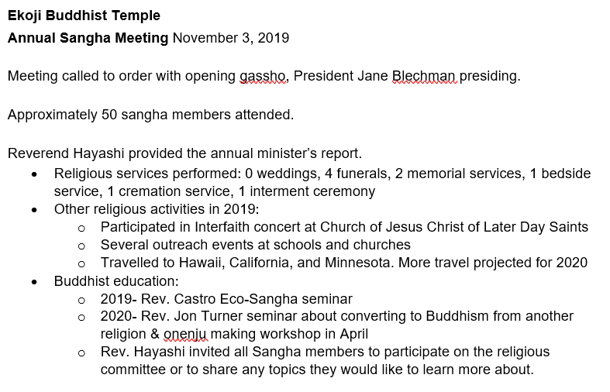
Vote on 2019 Annual Meeting Minutes

Slide 11
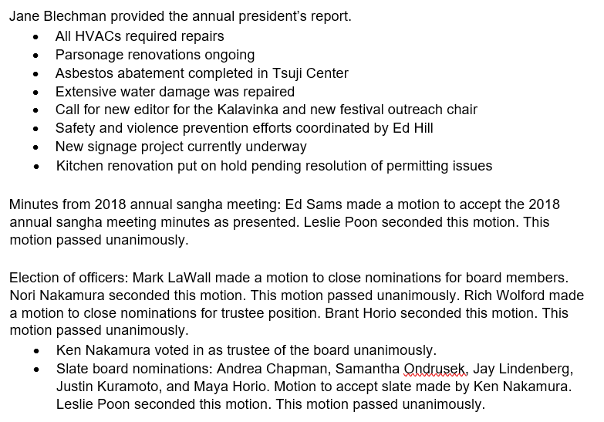
Vote on 2019 Annual Meeting Minutes

Slide 12
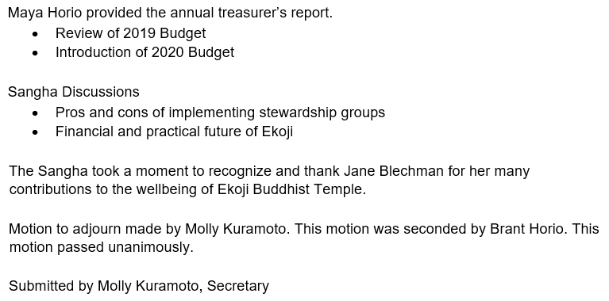
Vote on 2019 Annual Meeting Minutes

Slide 13
Election of Board Officers & Trustees
Nominations Committee—did not appoint this year
Concluded that our traditional approach has had mixed results
Sent letter to all Ekoji full pledged members seeking Board volunteers…no response
Included calls for Board volunteers in email notices…no response
Possible reasons:
2020’s focus on virtual programming probably decreased visibility of Board members’ efforts and contributions
Pandemic caused personal, professional, economic, health, spiritual changes for many—countless external competing priorities
Election Rules
Members as defined by membership application and pledge level may vote
Members as defined by membership application and pledge level may be nominated/self-nominate

Slide 14
Current Board & Trustees
Board Members
Andrea Chapman, Co-President**
Maya Horio, Co-President**
Molly Kuramoto*, Vice President**
Jay Lindenberg, Treasurer** (stepping down)
Justin Kuramoto*, Secretary**
Archer Harmon*, Director-at-Large (stepping down)
Mikio Yamashita, BDK Advisor
Trustees
Ken Nakamura (stepping down)
Rich Wolford*
* Completed 1- or 2-Year Term
** Executive Committee Position

Slide 15
Election of Board Officers & Trustees
Open Slate Due to Resignation and Term Closures is:
Three 2-year positions
Two 1-year positions
Trustees:
One 1-year position
One 2-year position
Presentation of Current Slate
Confirmation of Slate / Open Nomination from the Floor
Zoom Vote / Voice Vote
BOD (up to 5 positions)
Trustee (2 positions)
Closing Motion

Slide 16
2020 Financial Report
Highlights:
Sangha donations generally steady since initial dip in the spring with temple closure.
Virtual fundraiser vastly mitigated lost income from cancelling Obon festival.
Facility costs largely remain static even with temple closure…
…But decreased costs in service and sangha supplies and travel support have helped.
BDK’s financial and corporate support remains a huge asset to the temple.

Slide 17
Snapshot of Liquid Assets (as of 10/31/20)
Board of Directors Accounts…TOTAL: $ 586,738.41 (last year was $554,248)
PNC Checking Account (day-to-day operations): $ 188,900
PNC Ekoji 2 Checking Account (temple personnel): $ 16,145
PNC Money Market Account (operational reserve): $ 160,878
Morgan Stanley Investment Account (long-term growth): $ 220,815
Includes various restricted funds and Capital Campaign donations.
Trustee Accounts:
Morgan Stanley Investment Account (long-term growth): $ 185,490
Accounts ear-marked for minister, building, and property-related expenses.
Also includes a few shares of Texas Instruments and Citi Group stocks.
Non-liquid assets include Lakehaven Lane property and temple parsonage.

Slide 18
2020 Operations (projected through 12/2020)
INCOME | BUDGET
BDK Grant | $90,000
Sangha Donations | $60,000
Fundraising Events | $5,000
General Admin | $500
Education Activities | $1,200
Rentals -- Parsonage | $26,000
Rentals | $2,500
Obon | $24,000
TOTAL INCOME | $209,200
ACTUAL
$90,000
$57,995
$23,015
$4,876
$1,538
$25,284
$0
$1,675
$204,383
EXPENSES | BUDGET
General Administration | $7,000
Temple Personnel | $123,560
BCA/EDC | $14,000
Fundraising | $1,600
Parsonage | $1,000
Buddhist RC Education | $6,600
Dharma School | $400
Outreach/PR | $1,600
Hospitality | $800
Technology Support | $1,500
Facilities | $30,000
Misc. Facilities | $15,000
Obon | $6,000
TOTAL EXPENSES | $208,960
NET PROFIT/(LOSS) | $240
ACTUAL
$6,306
$120,603
$14,145
$2,187
$740
$449
$83
$1,225
$112
$2,364
$44,794
$0
$0
$193,007
$11,376
Extraord. Income
Cap. Camp. | $7,817

Slide 19
2021 Proposed Budget – Vote
INCOME | BUDGET
BDK Grant | $85,200
Sangha Donations | $60,000
Fundraising | $3,000
General Administration | $500
Education Activities | $1,000
Rentals- Parsonage | $24,500
Rentals | $750
Investment Fund | $0
Obon/Virtual Fundraisers | $30,000
TOTAL INCOME | $204,950
EXPENSES | BUDGET
General Administration | $7,000
Temple Personnel | $121,660
BCA/EDC | $14,000
Fundraising Events | $1,500
Parsonage | $1,000
Buddhist RC Education | $2,420
Dharma School | $200
Outreach/PR | $1,600
Hospitality | $400
Technology Support | $2,500
Facilities | $30,000
Misc. Facilities | $15,000
Obon/Virtual Fundraisers | $6,000
TOTAL EXPENSES | $203,280
NET PROFIT/(LOSS) | $1,670

Slide 20
Expressing Our Gratitude
In this year of major upheaval, the Board has felt immense gratitude:
For Rev. Hayashi, for his spiritual leadership, flexibility, & innovation
For our Minister’s Assistants and Rev. Hayashi’s family, for their behind-the-scenes contributions to the temple’s religious and operational activities
For BDK and Mr. Yamashita, for their unwavering support & partnership
For each of our Board members and Trustees, who more than pulled their weight
Especially to Andrea, for her technical prowess and creativity
For all of our volunteers:
Team Purple, garden caretakers, facility handy-folk, Dharma School teachers, office overseers, musicians, service chairs, fundraising committee members, discussion leaders, and more!
And most of all, to our sangha members, for your support, flexibility, and trust
We look forward to working with you in the coming year!

